Slide 1



SOFTWARE DEVELOPMENT PROFESSIONAL PROGRAM
Scaling up with Express

Slide 2





Scaling up with Express
Learning Objectives
Write both GET and POST routes in an Express app.
Test an app's functionality with Postman.
Access routes from a controller.

Slide 3
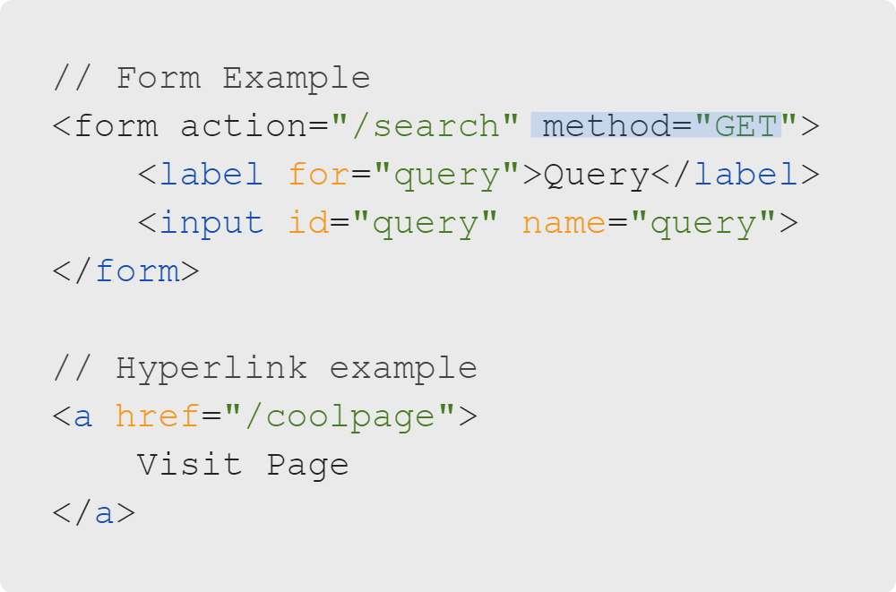
Scaling up with Express
Review: GET (Client Side)
How does a client generate a GET request?
Typing into your browser's address bar
Clicking a hyperlink
Submitting a form that uses the GET method
Notes:
Remember the "app.get()" method? In this case, GET refers to the HTTP verb.
We learned about the HTTP verbs GET and POST while learning about HTML forms.
Learners commonly misunderstand that these actions generate GET requests rather than another method.
This may be a good time to remind them that a form's default method is GET if a method is not specified.

Slide 4
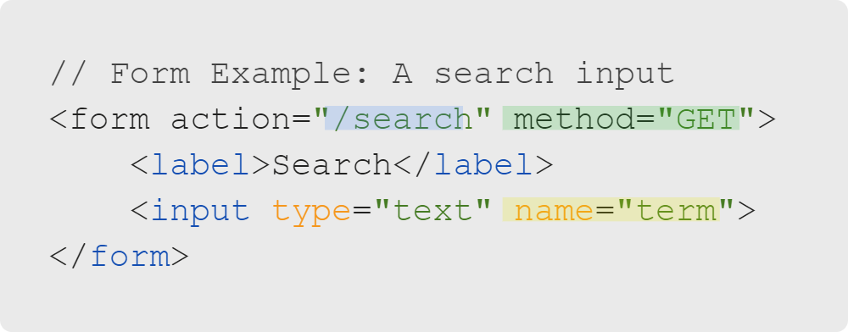
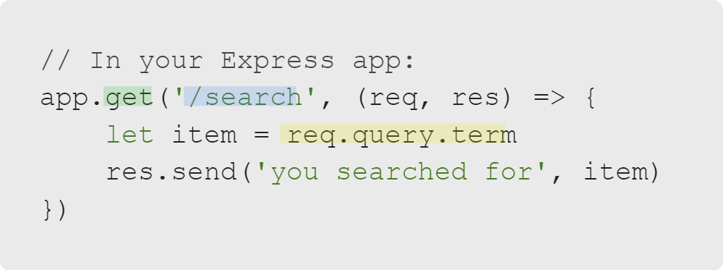
Scaling up with Express
Review: GET (Server Side)
How the server interprets the data the client sends
Green: The method (HTTP verb)
Blue: The path (URL part)
Yellow: The data (query)
Notes:
Clients and servers are two different machines trying to communicate with each other about the same data.
It can help if you take a moment to look at where the data from the client is interpreted by the server.

Slide 5

Scaling up with Express
Review: GET vs. POST
GET
POST
Visible data
Not encrypted
Good for public information (e.g., Google searches)
Data not visible
Encrypted
Good for private information (e.g., usernames and passwords)
Notes:
Note: Take a moment to perform a live demo.
1. Open Google.com and search for "cats."
2. Show learners the generated query string (part of the URL) where they can see "q=cats."
3. The result is a GET request passing data in action.
See Lesson Companion Exercise 1.

Slide 6
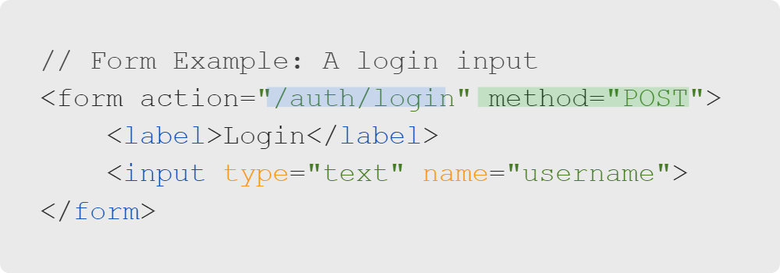
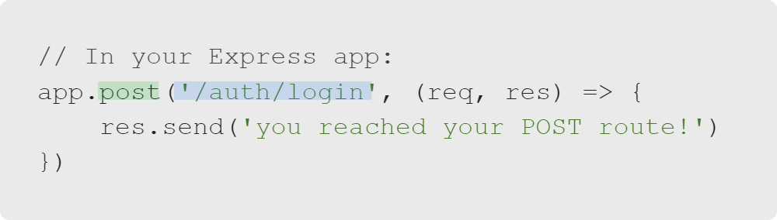
Scaling up with Express
POST (Server Side)
Use the app.post() method to receive a POST request.
You may have both a GET and a POST route for the /auth/login path.
Can you guess why?
Notes:
You can write POST routes the same way as GET routes. Simply change the method name from
"app.get()" to "app.post()".
You may have both a GET and a POST route for the "/auth/login" path.
GET may render the login form, while POST would receive your username and password and process your login.
See Lesson Companion Exercise 2.

Slide 7
Scaling up with Express
GET vs. POST
GET and POST: Different lanes on the same highway
Method | Path | Purpose
GET | /auth/login | Render a page with a login form
POST | /auth/login | Accept and process information from the login form
Notes:
Your POST route might also redirect the user to a profile page or dashboard page with
successful login credentials or provide an error message for invalid credentials.

Slide 8
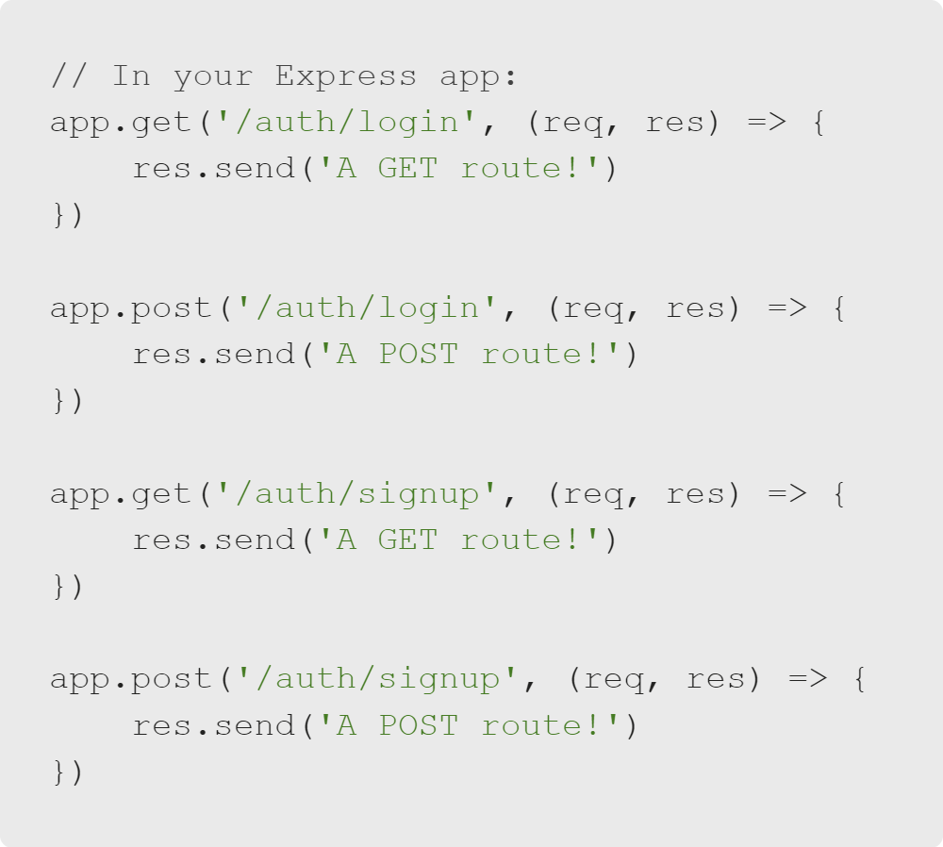
Scaling up with Express
An Issue of Scale
You can add more routes as needed.
But it becomes tedious quickly.
Notes:
Now that we are getting into back-end coding and defining different routes, it
may be time to think about how to organize and scale our projects.

Slide 9
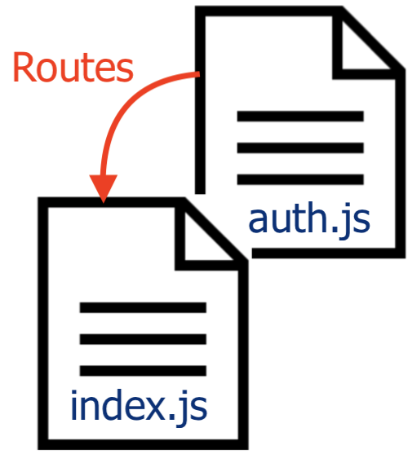
Scaling up with Express
Introducing Controllers
You can organize related routes into controllers.
Controllers allow you to put routes in another file besides index.js and help keep them organized by their purpose.
Notes:
Some people call their controllers folder "routes" or something similar.
Do as you like, but just be sure to explain this to learners.

Slide 10
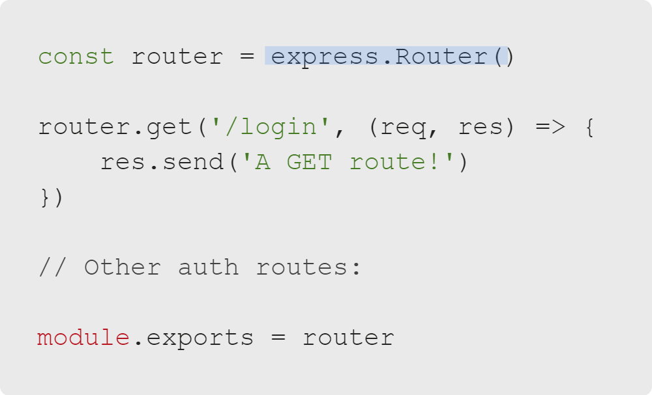
Scaling up with Express
Introducing Controllers
controllers/auth.js
To make a controller, call express.Router() and attach routes.
For example, you might extract your login and sign-up routes into a controller called auth.js.
Note: Module.exports allows you to export the router from auth.js and import it in index.js.

Slide 11
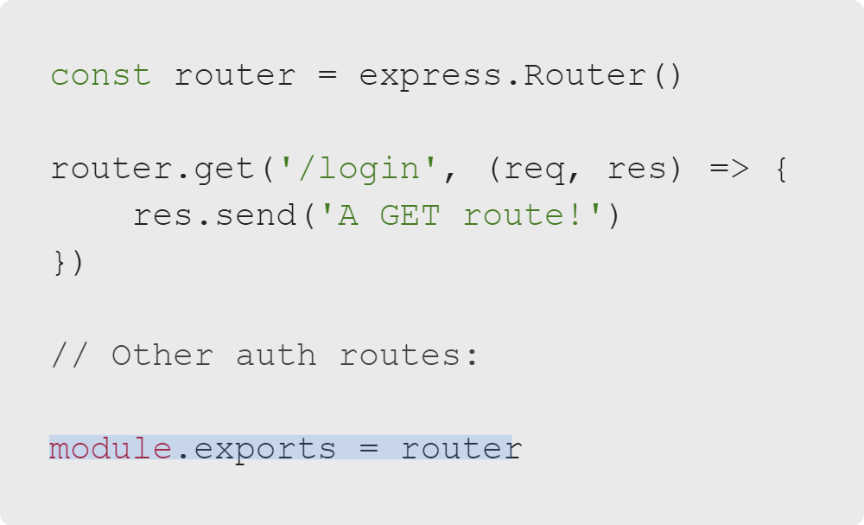
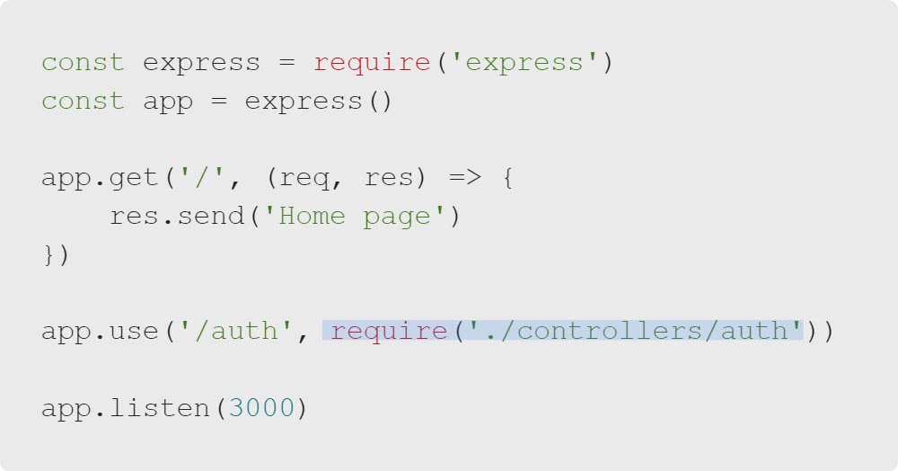
Scaling up with Express
Using a Controller
controllers/auth.js
index.js
(Export routes from this file)
(Import routes to your index.js file)

Slide 12

Scaling up with Express
Resulting Available Routes
Method | Path | Purpose
GET | / | Homepage
GET | /auth/login | Render a page with a login form
POST | /auth/login | Accept and process information from the login form
GET | /auth/signup | Render a page with a sign-up form
POST | /auth/signup | Accept and process information from the sign-up form
Notes:
Note that all these routes are part of the same application but don't need to live in the same file.
See Lesson Companion Exercise 3.

Slide 13

Scaling up with Express
Let's Discuss
As applications become larger, you have more and more routes.
What happens when you visit a route that doesn't exist?
How do you test these routes?
Notes:
As we scale up and make larger applications with more routes, two key questions
come to mind.

Slide 14
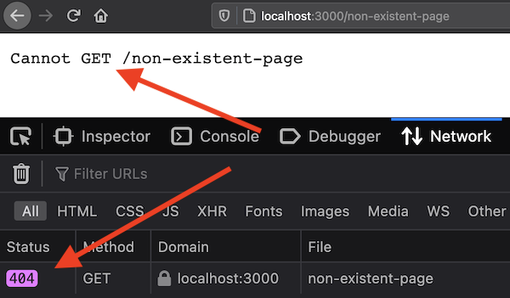
Scaling up with Express
Handling 404s
When you visit a non-existent page, you receive a 404 error, and the page crashes.
This isn't a nice user experience.
Luckily, there's a better way!
Notes:
Notice in the image that we are receiving a 404 status code. Errors can tell us a lot.

Slide 15
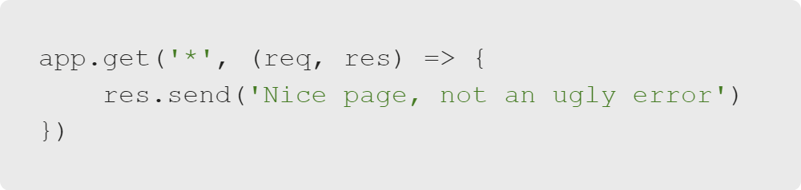
Scaling up with Express
Wildcard Routes
A catch-all (or wildcard) route matches every path.
This gives us the chance to render a graceful 404 page.
Remember, a catch-all route must come last. Otherwise, it will "catch" valid routes.
Notes:
Note: Depending on how far you have gone in the course, you could use regular expressions
for comparison and remind learners that they have seen wildcards before.
See Lesson Companion Exercise 4.

Slide 16

Scaling up with Express
Tools for Scaling
Sometimes we want to test a route without writing a full app.
Testing routes is best practice.
In this course, we will use a tool called Postman.
postman.com
Notes:
Sometimes you want to test a POST route without having to write a page with a form or filling out a whole
application full of pages before testing them.

Slide 17
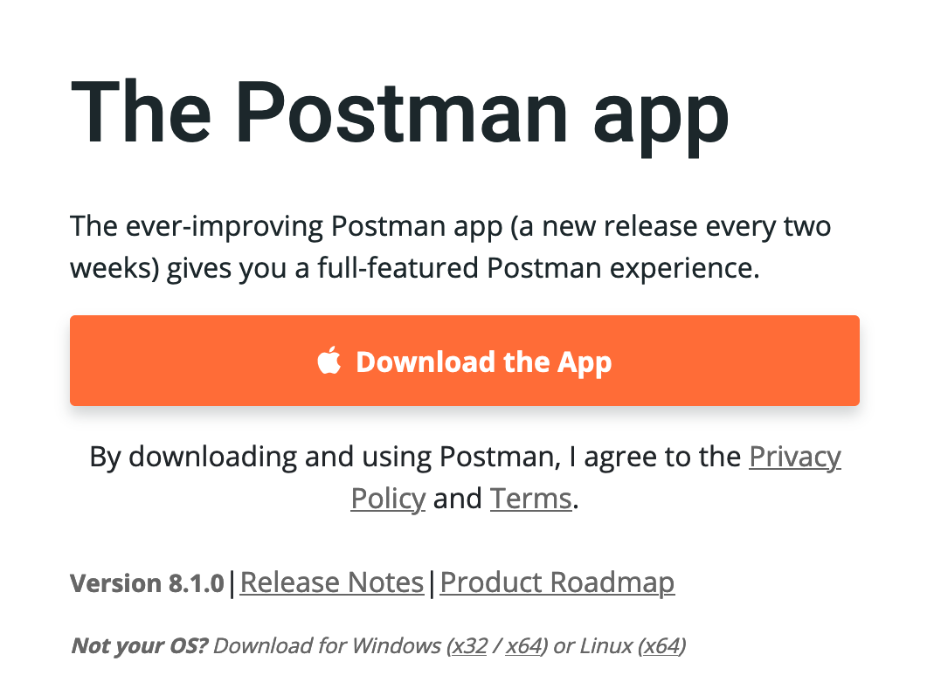
Scaling up with Express
Downloading Postman
Postman is often used for testing APIs and applications while they are in development.
We will download Postman during the activity.
Notes:
Note: Let learners know they will download and install Postman during the activity,
so there is no need for them to do it now.

Slide 18
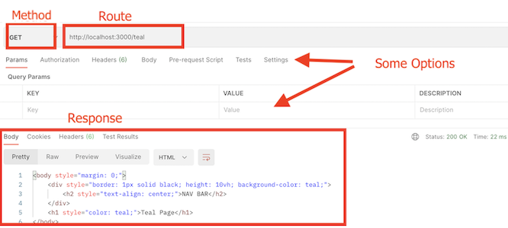
Scaling up with Express
Using Routes with Postman
Test a route without writing a full app.
Notes:
Sometimes you want to test a POST route without having to write a page with a form or filling out a whole
application full of pages before testing them.
Note: There's no need to go into too much detail about testing routes. If you have time, you can
demonstrate Postman, but it will be part of the next activity.

Slide 19


Scaling up with Express
Let's Put Ideas into Motion
Let's do it!
null
Notes:
Note: Move into the Trying out Postman code-along activity.

